Slide 1




SOFTWARE GROUP PROJECt
WEBGAME
APPLICATION
GAmes3

Slide 2
CONTENTS
Introduction
DOMAIN AREA
IMPLEMENTATION
PUZZLE WORLD
MEMORY CARD GAME
Where’s waldo
REFERENCES

Slide 3
INTRODRUCTION
Defination : A WEBSITE THAT HAVE THE OPTION OF THREE GAMES WHICH INCLUDES PUZZLE WORLD,MEMORY CARD GAME AND LOGICAL QUESTIONS.
The basic idea behind the game or the website app was to nurture our skills in website development and to take it to a next level using css.

Slide 4


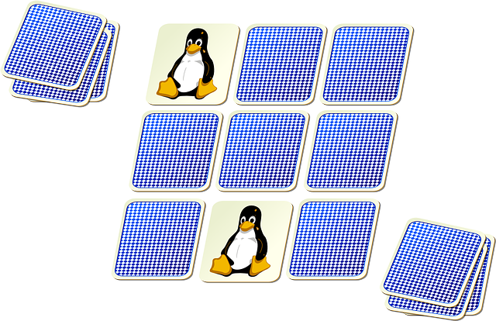
DOMAIN AREA
IT IS WEBGAME Application
A website which has the option of playing small games
These are some photos that depict our games precisely.

Slide 5



IMPLEMANTATION
WE MADE THIS GAME THE USE OF HTML,CSS AND JAVASCRIPT(JS).
HTML FOR TAXING.
CSS FOR WEBDECORATION AND ANIMATIONS.
JAVASCRIPT FOR MAINTAING EVENTS AND some ANIMATIONS.

Slide 6
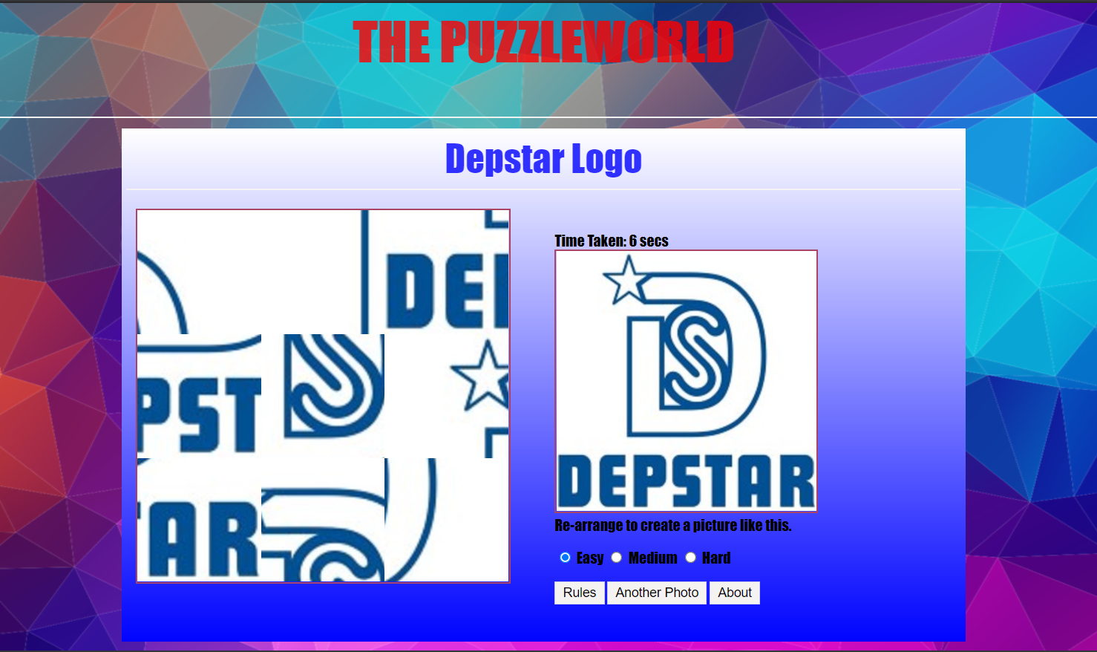
Puzzle world
This is a basic jumbelword type image game.
In this game user has to rearrange the images and make a perfect picture
Example is shown below.

Slide 7
Memory card game
In this game we give user play board which contains some types of hidden pictures.
the user has to make the same pair of those pictures.
When user pairs all images then the user wins.

Slide 8
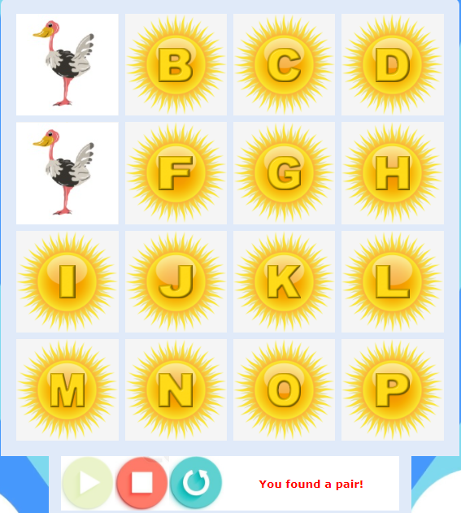
Memory card game cont.

Slide 9
Where’s waldo

Slide 10
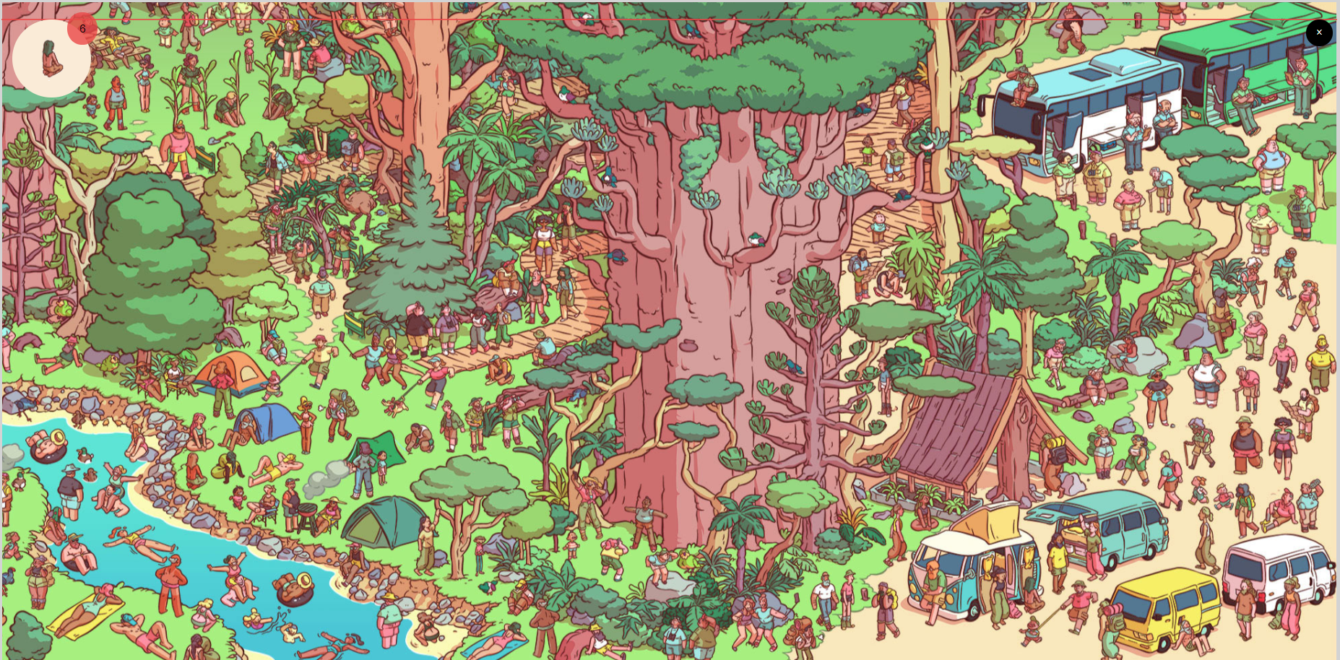
Where’s waldo CONT.

Slide 11
references
https://codewithharry.com/playlist/web-development
For images : https://pixabay.com/
https://www.youtube.com/watch?v=QocWxqA28Ds&list=PLbu98QxRH81KxxMclY_ZRmm4Dac-n7cSA
https://nicepage.com
And some other sites…..

Slide 12
Thank you
BY-
Aamir Ansari (19dce002)
Anshul gorasiya(19DCE034)
sanat kakadiya (19dce050)

